Slide 1

Amazon Sales Analysis

Slide 2
Table of Contents |  |  |  |  | \\\\
What is Amazon? Problem Statement Process Dashboard Insights Summary

Slide 3
What is Amazon?
Amazon.com is an E-Commerce platform that sells various product lines, including media (books, movies, music, and software), apparel, baby products, consumer electronics, and beauty products. Amazon.com had approximately 2.5 billion+ combined visits. Net sales down from $520+ billion in 2023 compared with $510+ in 2022. It operates over globe, with numerous retail websites. Services like Amazon Prime providing fast shipping with streaming content and other membership benefits.

Slide 4
Problem Statement
Sales management has become more important because of growing competition and the need to find better ways to distribute products, reduce costs, and boost profits. Analyzing Amazon’s extensive sales data can be challenging, but it's crucial for refining sales strategies, improving customer satisfaction, and boosting profitability. By effectively interpreting this data, businesses can make informed decisions that lead to better outcomes and long-term success. The Amazon Sales Analysis Project addresses this by utilizing Python for Data Visualization and Power BI to create interactive dashboards that provide clear, actionable insights into sales trends, revenue, and market dynamics for better understanding of the sales.

Slide 5
Process
Data Collection
Data Analysis
Data Cleaning
Uncovering Insights

Slide 6
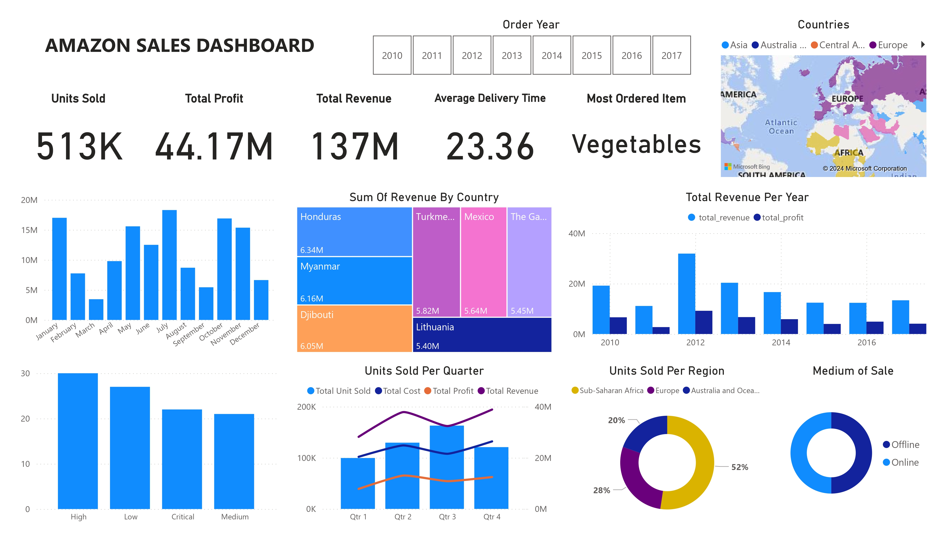

Slide 7
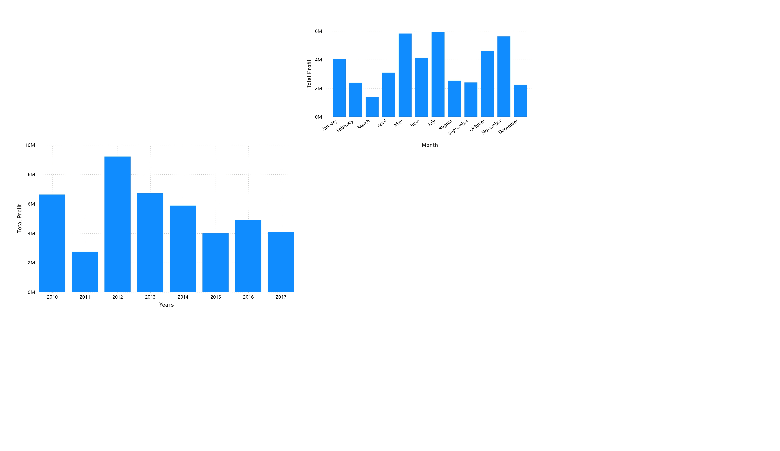
Insights
Data Analysis
Data Cleaning
In 2010, profits surpassed $6 million, but there was a sudden decline in 2011. By 2012, profits rebounded, exceeding the $8 million mark. However, since then, there has been a gradual decline in profits.

Slide 8
Insights
Data Analysis
This represents the average profits from 2010 to 2017. Notably, January and June have nearly the same profit levels. May, July, and November stand out, each surpassing the $5 million mark, making them the months with the highest recorded profits across all years.
Data Cleaning

Slide 9
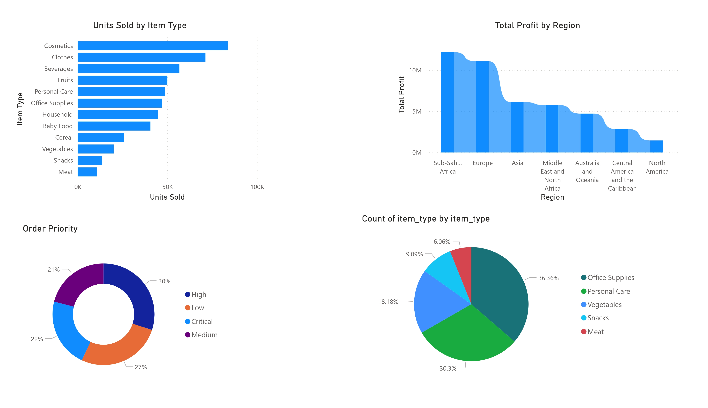
Insights
Data Analysis
Data Cleaning
Amazon's top-selling items include Cosmetics, Clothes, and Beverages, showing strong consumer demand in these areas. In contrast, Meat, Snacks, and Vegetables are sold less often, possibly due to their perishability or customer preference for buying these items in stores.

Slide 10
Insights
Data Analysis
Data Cleaning
The Sub-Saharan Africa region leads in total profit, followed by Europe in second place and Asia in third. The Middle East ranks next, with Australia coming after. Central America and North America have the lowest profits, Asia with a notable drop in profits after Europe.

Slide 11
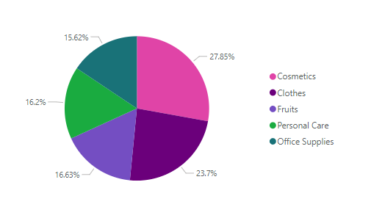










Insights
Data Analysis
"High" is the most common order priority, associated with the highest number of sales.
The top 5 items by units sold are as follows: Cosmetics lead with 27%, Clothes are second at 23%, Fruits hold a market share of 16.63%, Personal Care comes next at 16.2%, and Office Supplies follow with 15.62%
Data Cleaning

Slide 12







Summary
Sales increased in starting of year and ending of a year, and in 2010 year, the increase in sales and then decrease and increase in 2015 and 2017. 2012 was the best performing year in terms of profits. The order priority of “High” sales is more than other orders. We can observe that “cosmetics” and “clothes” are more purchased than the other items. Beverages are the third most purchased item. Also Meat, Snacks and Vegetables are least purchased item. Sub Saharan and Europe’s total profits are significantly higher, there is a downfall at Asia, this means that most of our customers are from the Sub Saharan and Europe’s market. North American performed bad in terms of total profits.

